Slide 1
Welcome To StrayAway
GROUP 4 CMSE201

Slide 2
Project Aim
The system's purpose is to get stray animals off the streets and into a loving home which reduces noise, environmental as well as visual pollution on the streets
Notes:
Mohamed

Slide 3
Functional requirements
Are split into categories:
-User registration and profiles
-Notifications and alerts
-Donation and fundraising
Notes:
Mohamed

Slide 4
User Registration And Profiles
REQ-1: New users shall be able to register a new account.
REQ-2: Users shall be able to change their profile username
REQ-3: Users shall be able to change their pet wishlist.
REQ-4: Users shall be able to provide new contact information or edit it.
REQ-5: Users shall be able to turn on 2 factor authentication
REQ-6: Users shall be able to change the language of the app/website.

Slide 5
Notifications and Alerts
REQ-1: The user shall be able to customize the content of notification
REQ-2: The user shall have the option to receive notifications via email.
REQ3-: The user shall receive notifications promptly for timely information.
REQ-4: The notifications should be delivered in the user’s preferred language.
REQ-5: The user shall be able to turn off notifications and alerts.
REQ-6: The system shall provide clear instructions on how to enable and disable notifications.

Slide 6
Donation and fundraising.
REQ-1: user shall be able choose the amount they want to donate.
REQ-2:user shall be able to choose what payment method they want to use in the donation.
REQ-3:The user shall be able to share their donations on social media.
REQ-4: The user shall be able to see the donation goal and its current status.
REQ-5: The user shall be able to donate anonymously
REQ-6: The user shall have the option to make recurring donations.
This Photo by Unknown author is licensed under CC BY-NC.

Slide 7
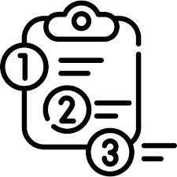
Non-Functional Requirements
The essential components of Non-functional requirements consist of:
-Performance Requirements
-Safety Requirements
-Security Requirements
Software Quality Attributes(Availability, Usability, Maintainability, Robustness)

Slide 8
Performance Requirements
The app should be able to run within a short time frame
The system must be able to handle increasing numbers of concurrent users and transactions
The system should be able to process a high volume of data efficiently
The system should ensure that multiple users do not face significant delays
The system should ensure that security measures do not have an unexpected impact on performance.
The system should have the ability to handle hardware and software failure
The system should have an availability of 95% to ensure the app is consistently available for customers

Slide 9
Safety Requirements
Encryption is required for any communication between the information server of the framework and its clients that happens remotely.
The system should be saving and backing up data in case of system failure to the clouds.
The system should provide tips and guidelines to educate the user on how to use this app.
The system should encrypt communication channels to protect unauthorized access to data.
The system should implement secure account recovery to ensure legitimate users can regain the account if needed.

Slide 10
Security Requirements
Encrypt user information, animals' data, and other sensitive information in the database.
Enable users to share their location when needed.
Regularly backup data for secure storage.
Provide account protection tips to educate users.
Implement comprehensive logging to track user activity.

Slide 11
Software Quality Attributes – Availability and Usability
Availability:
-The system should be available during all hours of the day.
The system’s uptime percentage should be 99.8%
The system’s MTBF (Mean Time Between Failure) should be approximately 5000 hours
Usability:
The system should have a user-friendly user interface.
The system should have a FAQ page to help guide users in using the system.
The system should be efficient.
The system should prompt users to complete a survey on their satisfaction with the system’s usability.
The systems user error rate should be at most 8%
The system should provide multi-language support.

Slide 12
Software Quality Attributes- Maintainability and Robustness
Maintainability:
The system should easily adapt to changes
The system maintenance should be cost efficient
The system’s MTTR (Mean Time to Repair) should be at most 5 hours
The system should not have to be changed frequently
Robustness
The system should retain its essential functionalities if other functionalities are not working.
The system should function properly in all smartphones OS and platforms.
The system’s error rate should be 5-10%.

Slide 13
Functional Actors
-User
-Administrator
-Vets
-Adoption Clinic Employee

Slide 14
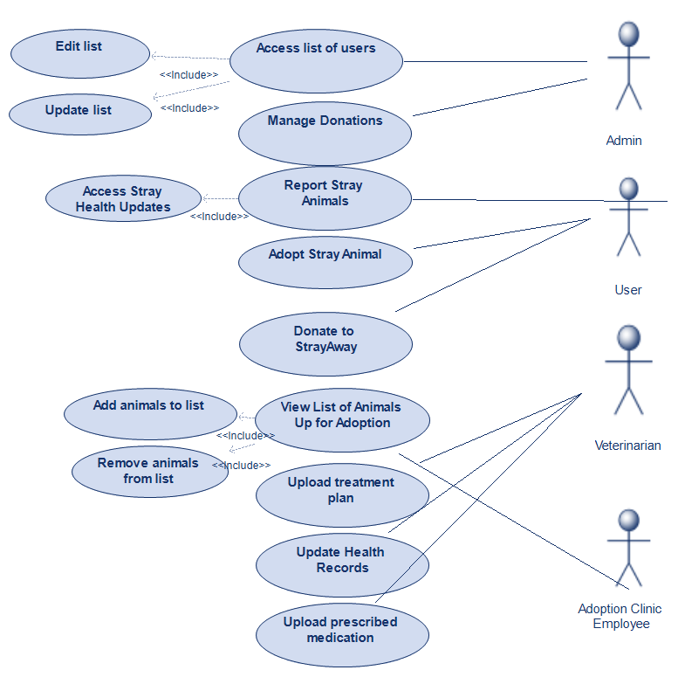
Use-Case Diagram

Slide 15
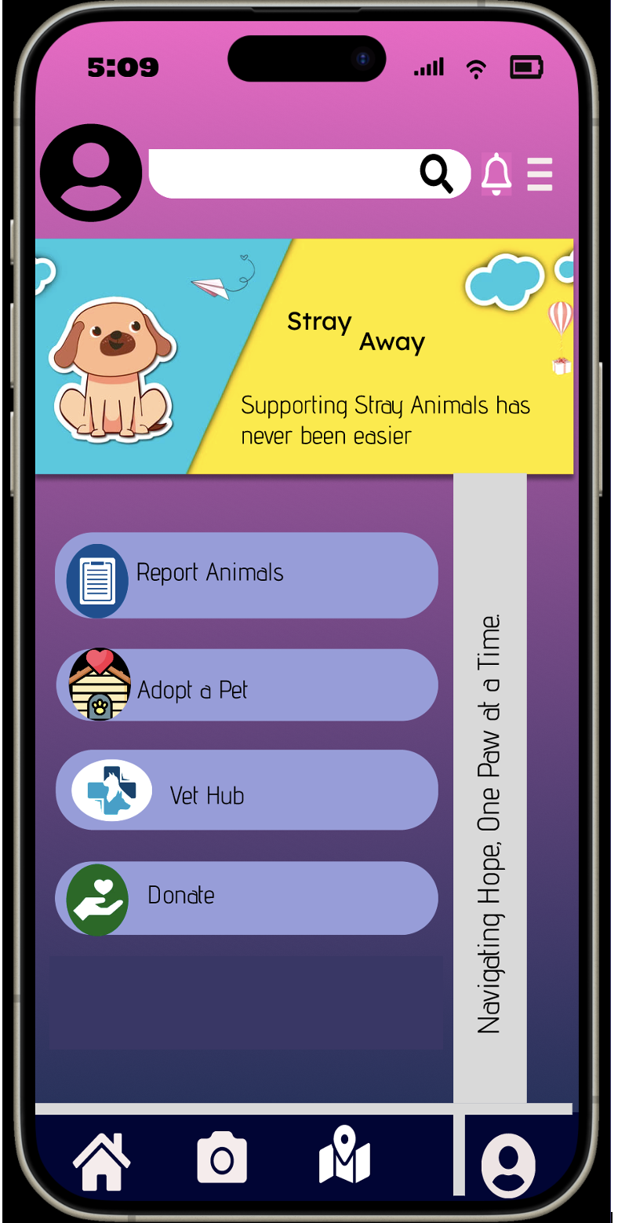
User Interface Design
Home Page

Slide 16
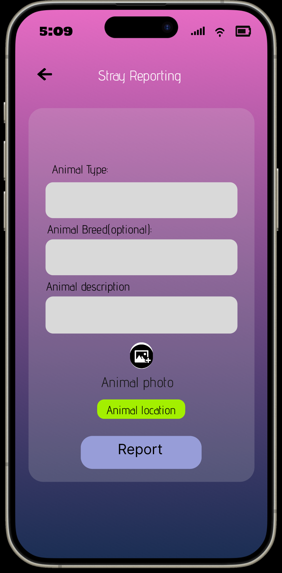
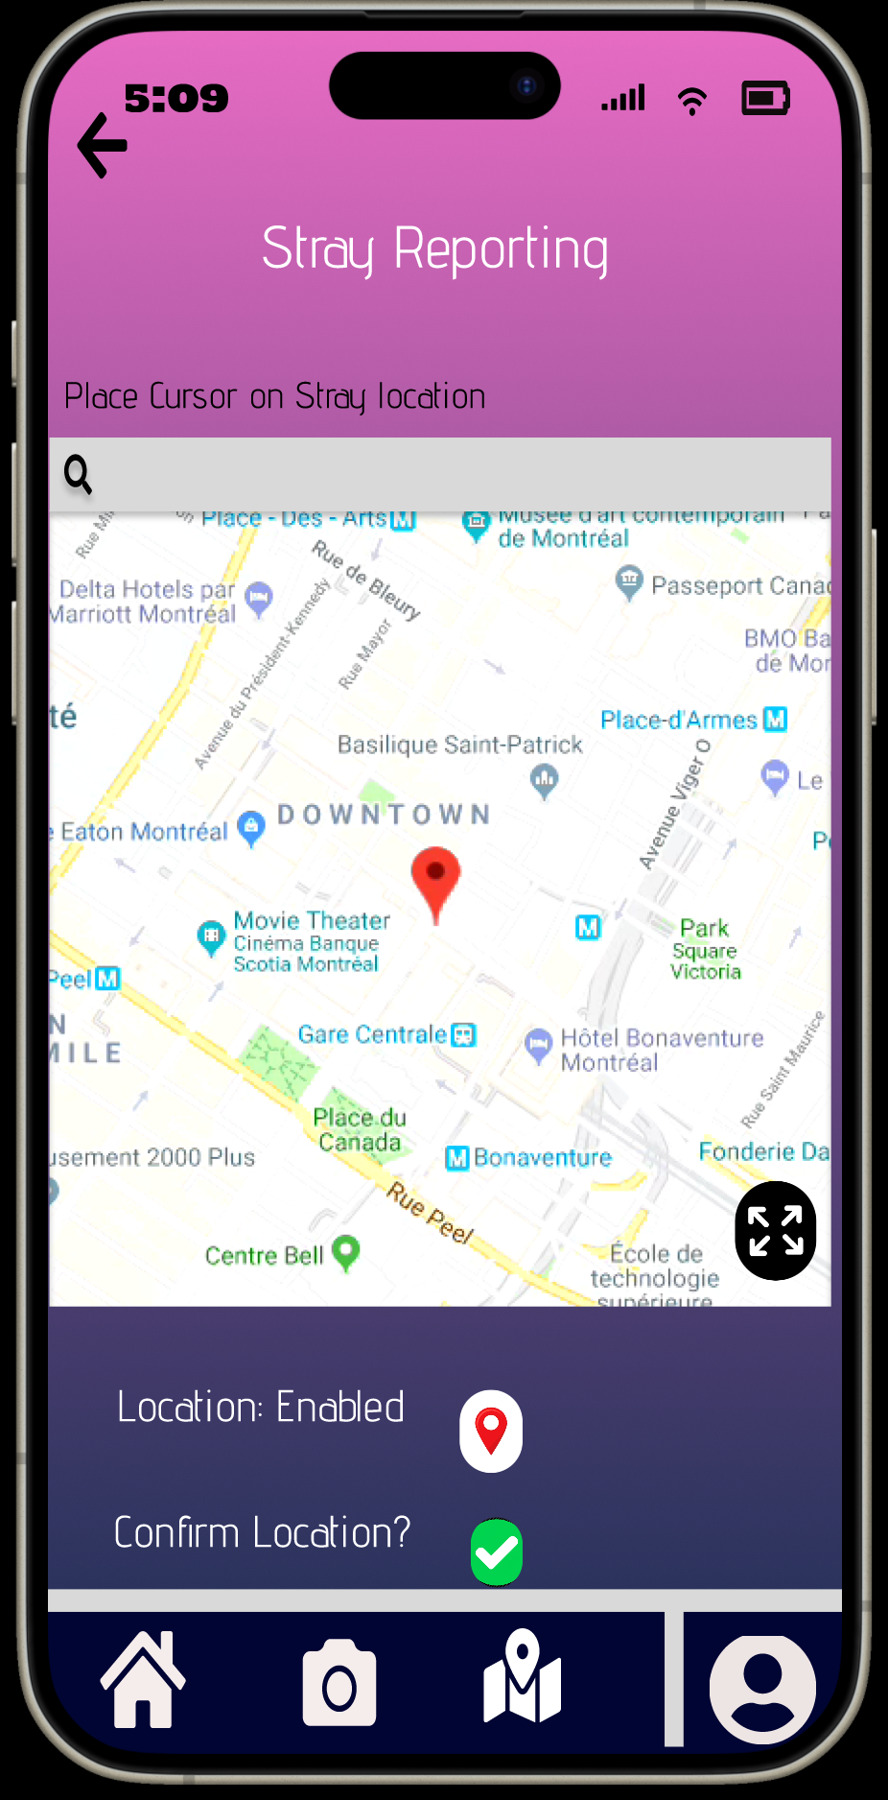
Reporting A Stray Animal

Slide 17
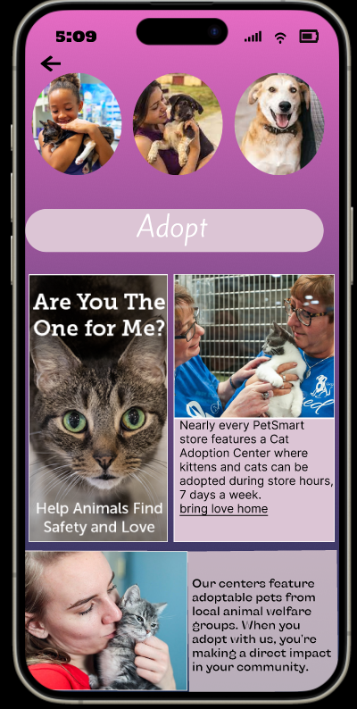
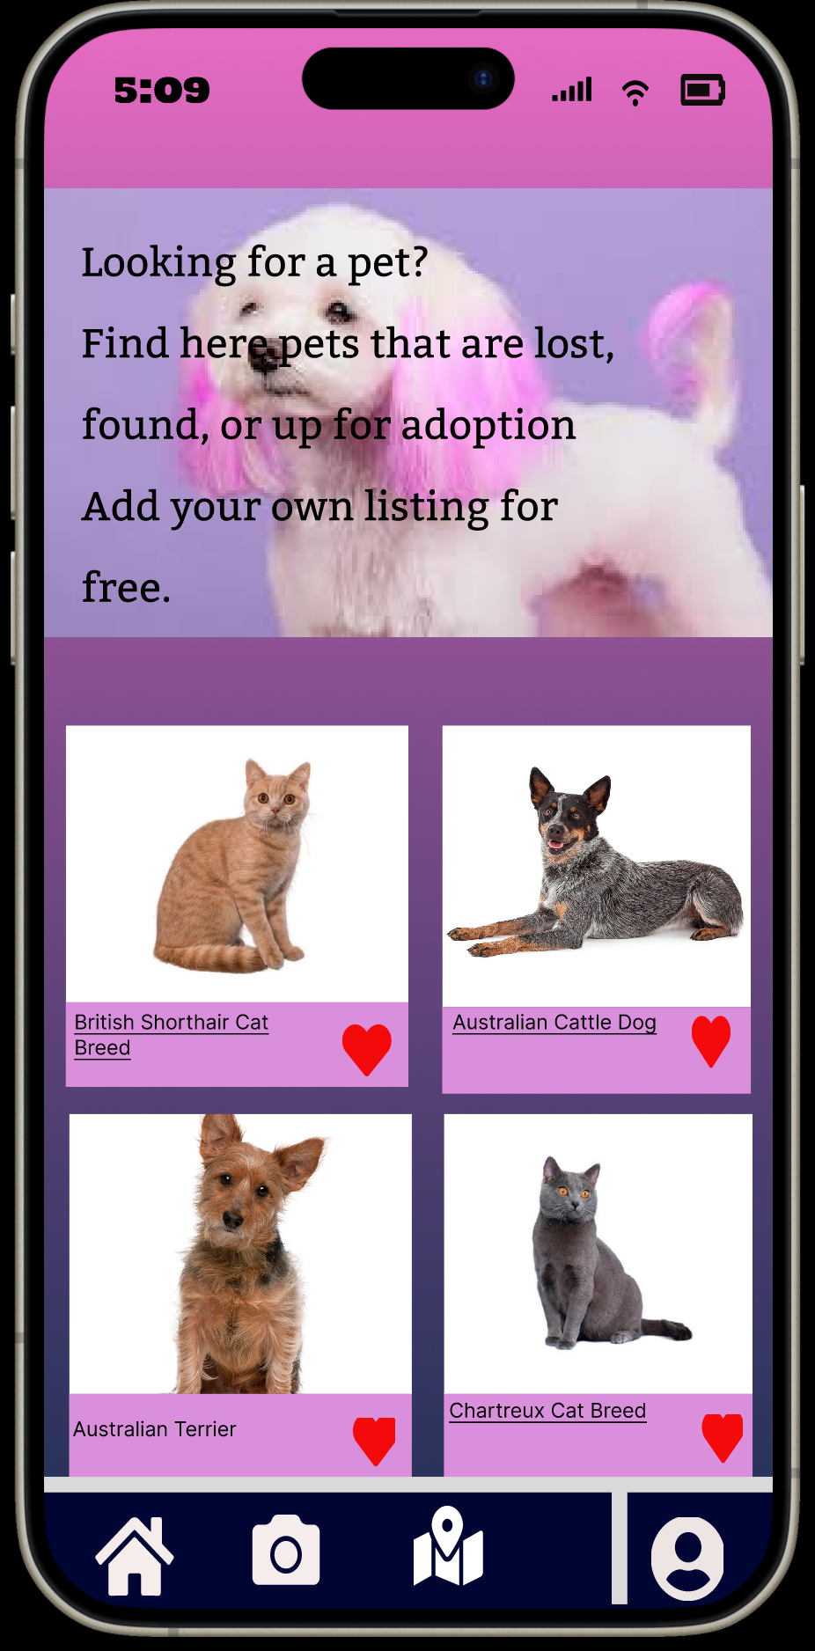
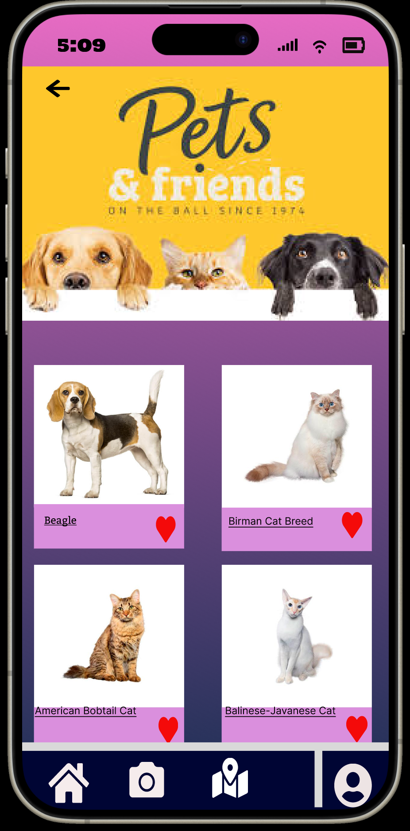
Adopting A Stray Animal

Slide 18
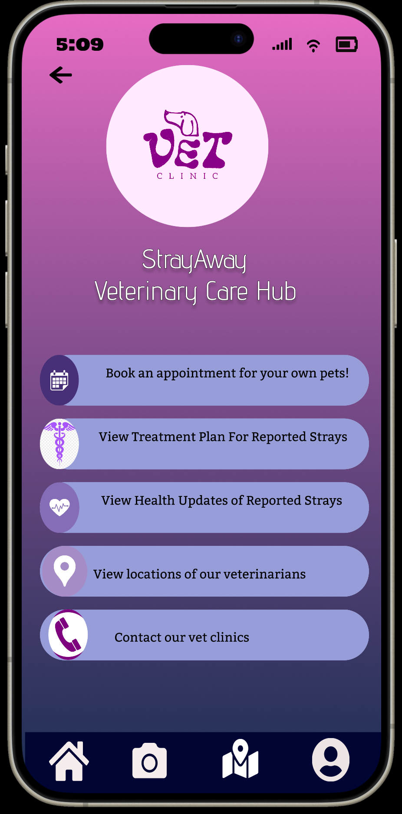
Checking health updates from the vet hub

Slide 19
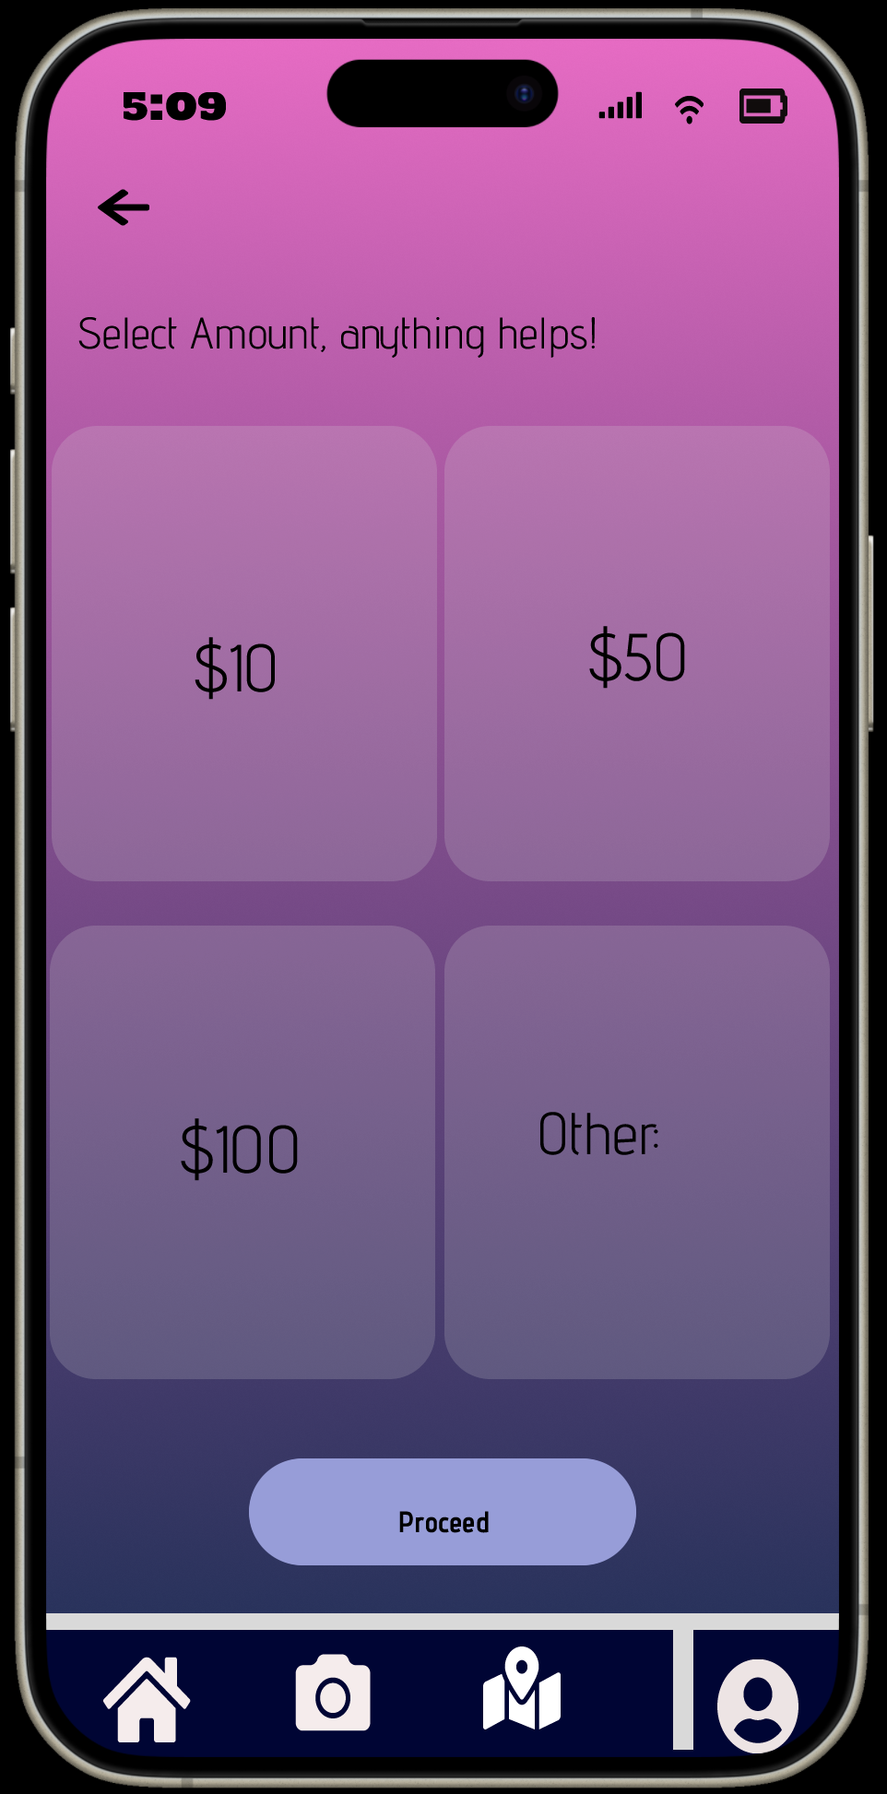
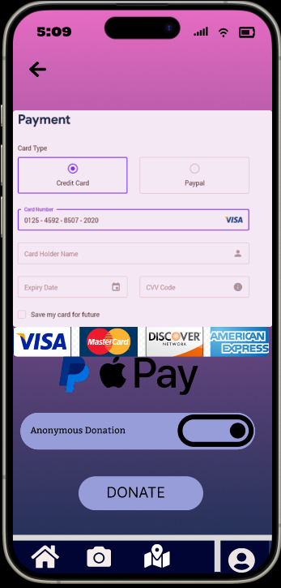
Sending donations

Slide 20
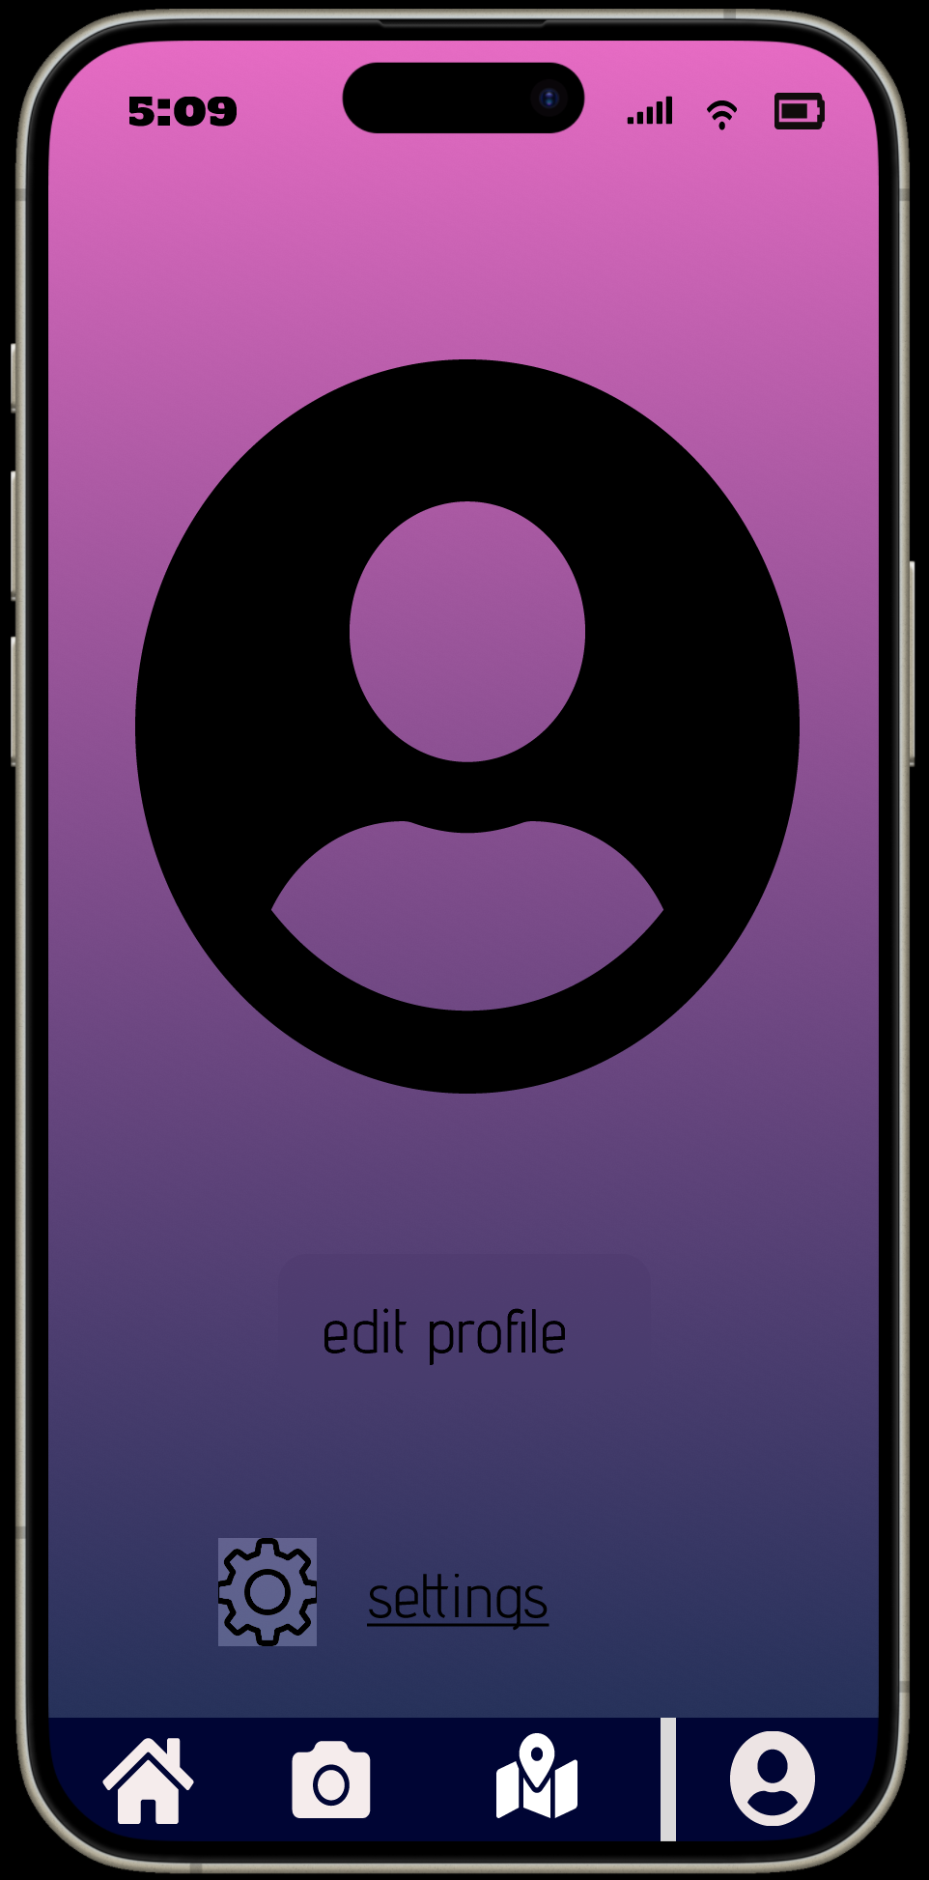
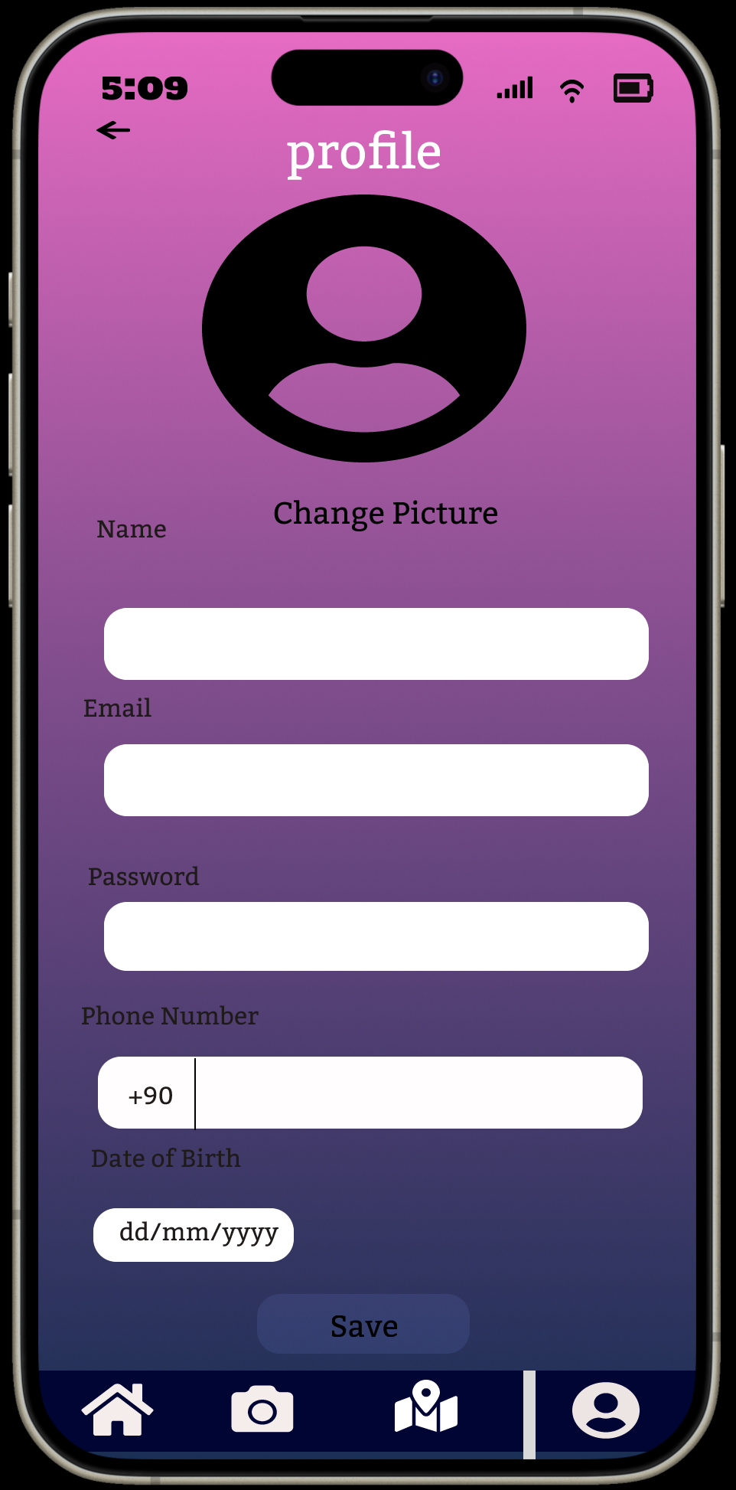
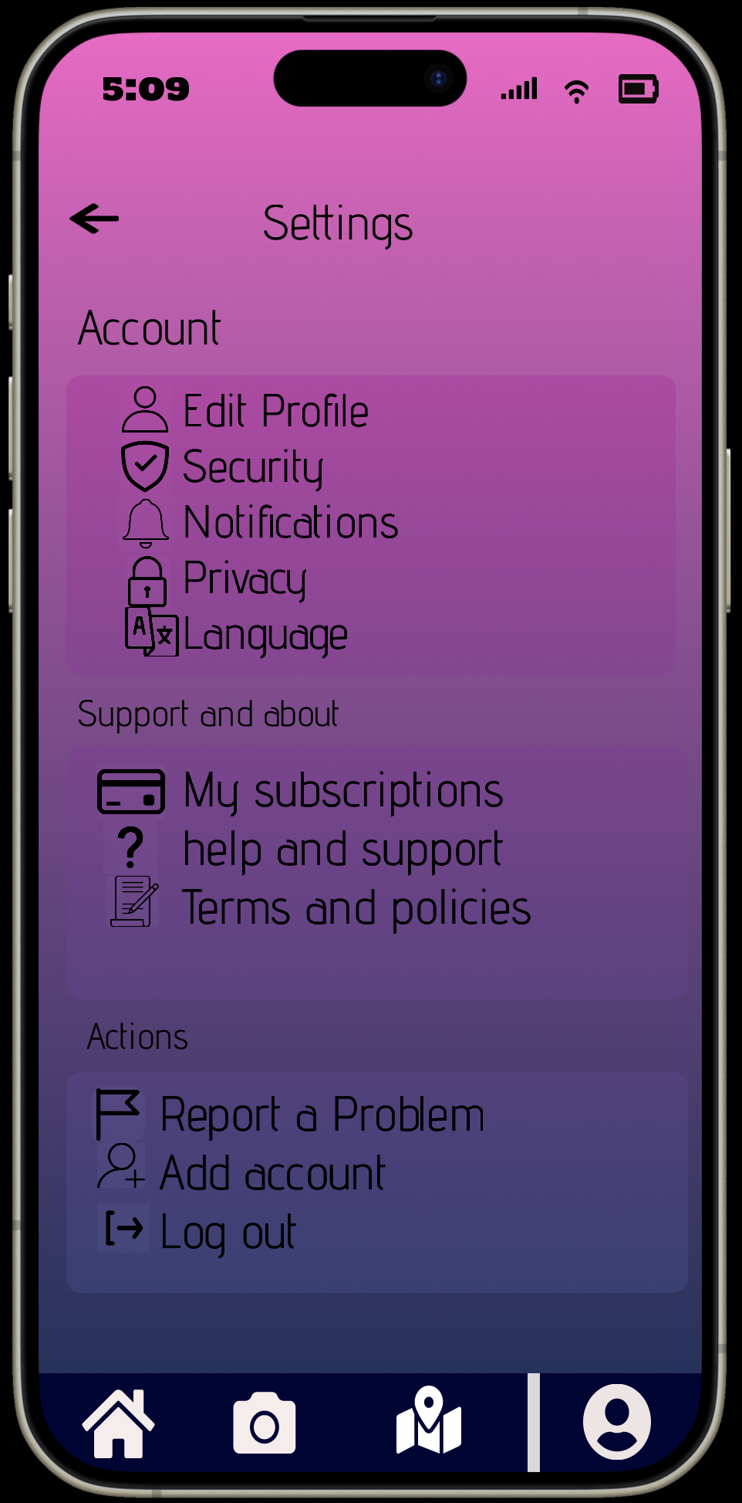
Editing user info

Slide 21
The End

